Slide 1
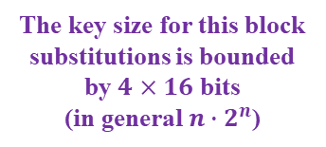
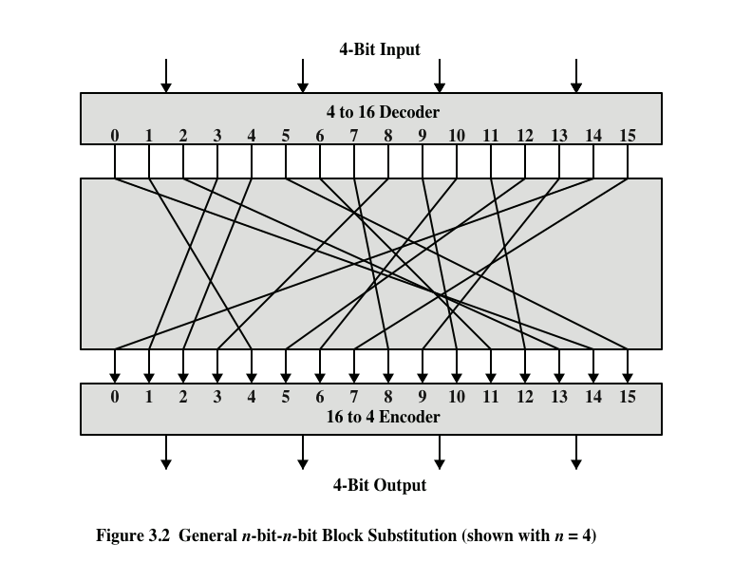
Block Substitutions Ciphers
The key size for this block
substitutions is bounded
by $4×16$ bits
(in general $n∙2^{n}$)

Slide 2
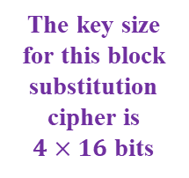
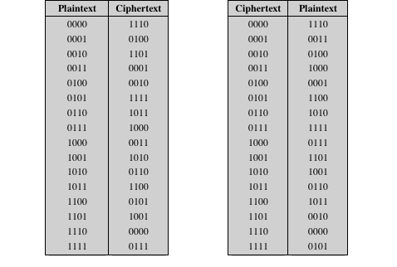
Encryption and Decryption Tables for Block Substitution Cipher
The key size
for this block
substitution
cipher is
$4×16$ bits

Slide 3
Motivation for Feistel Cipher
A Block cipher that combines substitution & transposition ciphers
Based on a proposal by Claude Shannon to develop a product cipher that alternates confusion and diffusion functions
Transposition for diffusion
If a single bit of the plaintext is changed then roughly half of the bits of the ciphertext change. Similarly for the ciphertext.
Each bit of the ciphertext depends on several parts of the encryption key
Substitution for confusion
Makes the relationship between the statistics of the ciphertext and the key complex
The statistical structure of the plaintext is dissipated into long-range statistics of the ciphertext

Slide 4
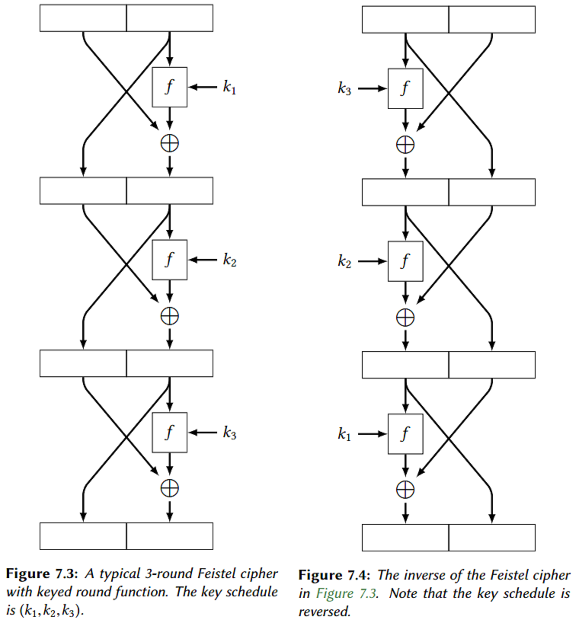
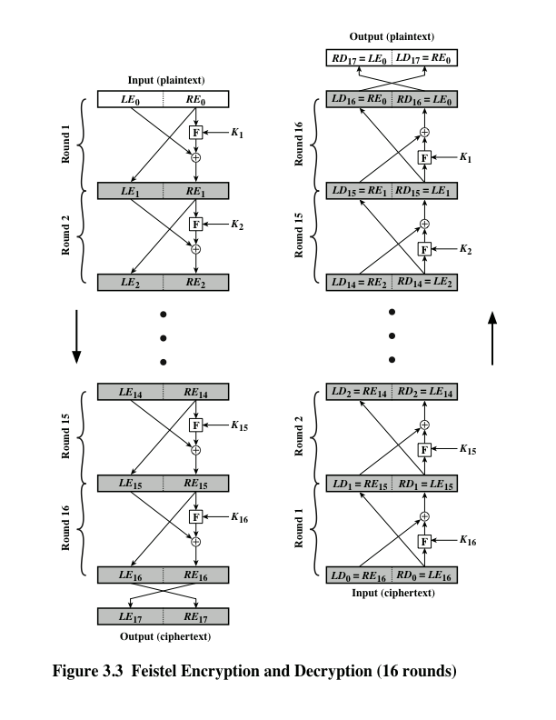
Feistel Cipher Structure
}
{
transposition
substitution
{
Transposition
Cycle transposition
move bits 32 places
}
Substitution
Vigenère Autokey System

Slide 5
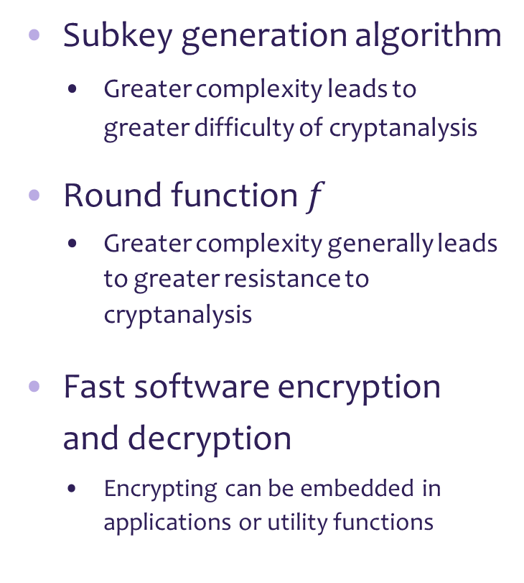
Feistel Cipher Design Features
Block size
Larger block sizes mean greater security but reduced encryption/ decryption speed
Key size
Larger key size means greater security but reduces encryption/ decryption speed
Number of rounds
Multiple rounds offer increasing security
Subkey generation algorithm
Greater complexity leads to greater difficulty of cryptanalysis
Round function $f$
Greater complexity generally leads to greater resistance to cryptanalysis
Fast software encryption and decryption
Encrypting can be embedded in applications or utility functions

Slide 6
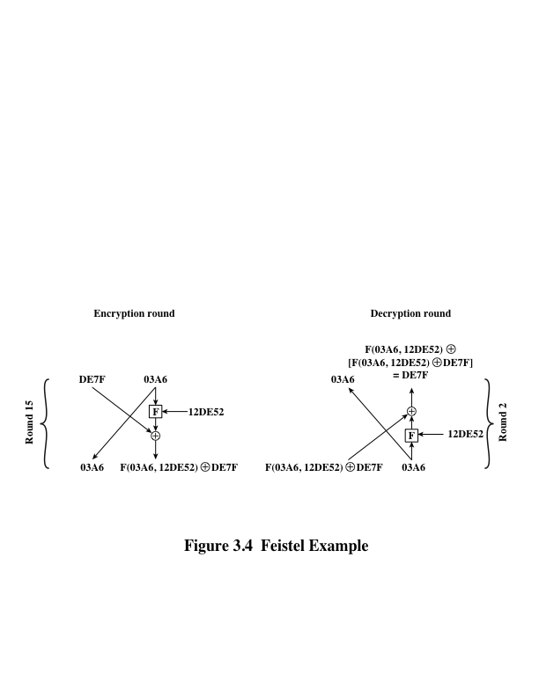
Feistel Example
Feistel Example

